Slide 1

Movie Review App
Proceed forward to find the best possible recommendations!

Slide 2
Index:
Mercury
Venus
Mercury is the closest planet to the Sun
Venus is the second planet from the Sun
Jupiter
Saturn
Jupiter is the biggest planet of them all
Saturn is composed of hydrogen and helium

Slide 3
Introduction:
Finding media to watch takes a long time and more often than not consumes more time than the time spent watching it. Our system helps save time for users by recommending movies, tv shows, etc. to watch that is similar in genre, ratings, etc. to the type of media the user likes to watch.

Slide 4
Scenario for Implementation:
People watch various tv shows, movies, etc. But at the same time they spend a lot of time surfing the net to find the perfect show for them. Our system will help to save the users time by providing them with the perfect show for them which will be based on the choices chosen by the users in our system.

Slide 5
Problem Definition:
Our recommendation system takes user's media consumption data such as previously watched movies, tv shows, etc, and their likes and dislikes and based on this data it recommends similar media that the user may like. It then allows the user to rate the recommendations and based on the rating, tries to improve the recommendations further.

Slide 6
Scope of the project:
This system will help to provide users with with the freedom of choice of watching shows, movies etc which are similar to their taste.
This will save time of the users since they won't have to surf the net for new shows, movies, etc.

Slide 7
Requirements:
Modules for : Searching various movies,tv-shows,etc , watching them, having similar ones recommended.
Provide a user friendly website for fulfilling the above module.
Provide assistance to use this software and also prevent any inconsistency in the operations.

Slide 8
System Design:
Finding media to watch takes a long time and more often than not consumes more time than the time spent watching it. Our system helps save time for users by recommending movies, tv shows, etc. to watch that is similar in genre, ratings, etc. to the type of media the user likes to watch. People watch various tv shows, movies, etc. But at the same time they spend a lot of time surfing the net to find the perfect show for them. Our system will help to save the users time by providing them with the perfect show for them which will be based on the choices chosen by the users in our system.

Slide 9
System Design(continued):
Our recommendation system takes user's media consumption data such as previously watched movies, tv shows, etc, and their likes and dislikes and based on this data it recommends similar media that the user may like. It then allows the user to rate the recommendations and
based on the rating, tries to improve the recommendations further.
This system will help to provide users with the freedom of choice of watching shows, movies etc which are similar to their taste.
This will save time of the users since they won't have to surf the net for new shows, movies, etc.

Slide 10
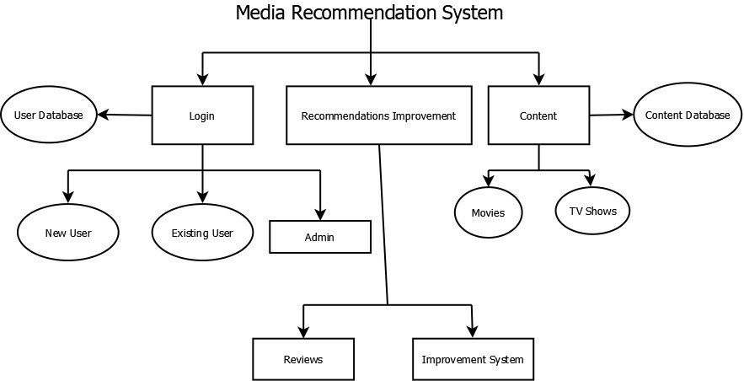
System Architecture:

Slide 11
Our Focus:
Login
This is for both, the admin and the users to secure and prevent unauthorized access to confidential data.
Recommendations Improvement
This is to help the users , to try solving their problems based on their feedback on every recommendation which is being given to the user looking to the selection they have made earlier.
Dashboard
A display of all the content like movies, tv shows at a place that helps the users to select what they are interested in.

Slide 12
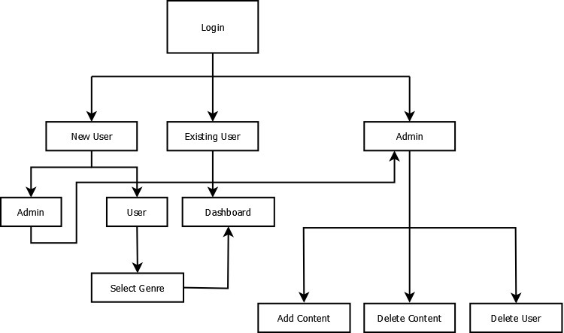
Module wise flow diagram:
1. Login:

Slide 13
Functionality of the Login Page:
This is for both the admin and the users , to secure and prevent unauthorized access to confidential data.
This also helps the user to store the information or their preference they have selected for the future use .

Slide 14
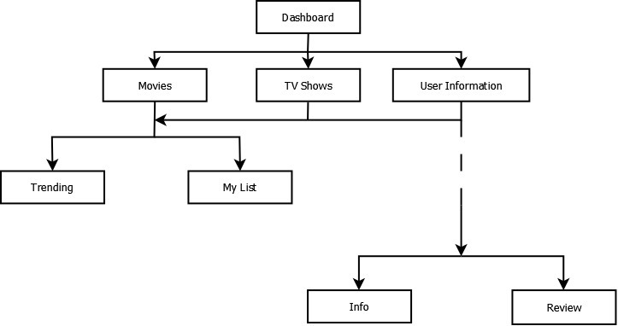
Module wise flow diagram:
2. Dashboard:

Slide 15
Functionality of the Dashboard:
It is divided in 3 parts. Movies , Tv shows and User Information
It shows the trending list of the movies and tv shows which are more liked by the users and the preferred list which is being selected by the user based on the recommendation.
In the User Information , the user can check the personal information and also can review the movie or tv show that the user was recommended by the system.

Slide 16
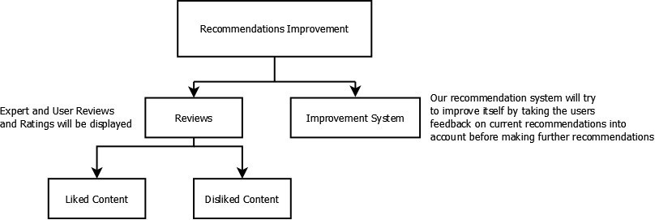
Module wise flow diagram:
Recommendations improvement:

Slide 17
Functionality of the Recommendation improvement:
This system will try to improve itself by analysing the users feedback on current recommendation which was made by the system ,before making any further recommendations.
It also has a feature of ‘Liked ‘ and ‘Disliked’ which makes it easy for the system to give recommendations based on the preference they have selected

Slide 18
Programming languages used:
modularity and structuring; We will be using Python and Flask as a backend for our website to add modularity and structure.
headers and commenting; Headers and commenting will be provided within the python backend code
indenting and layout; We will be using HTML and CSS for the layout and structure of our website
library routines to be used; We will be using python’s flask, pandas and beautiful soup libraries to help implement the algorithms and backend
language constructs to use; We will be using the basic python language constructs of keeping the code simple, clean, and easily readable.
language constructs to avoid. We will be avoiding using too many python libraries which will make our project more portable and easy to run everywhere.

Slide 19
Software development tools:
an application development too;
b. HTML authoring tools;
c. a word processor for documentation;
d. a tool for drawing diagrams;
e. automated testing tools.

Slide 20
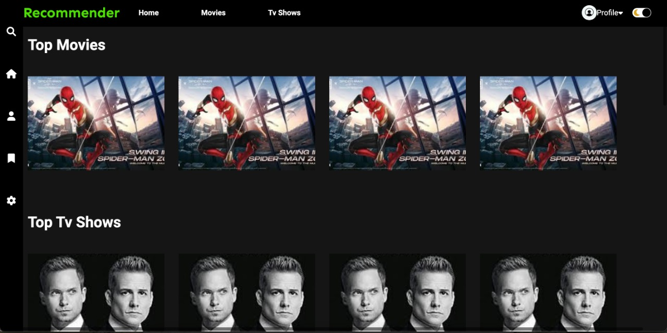
Front End Web Pages:

Slide 21
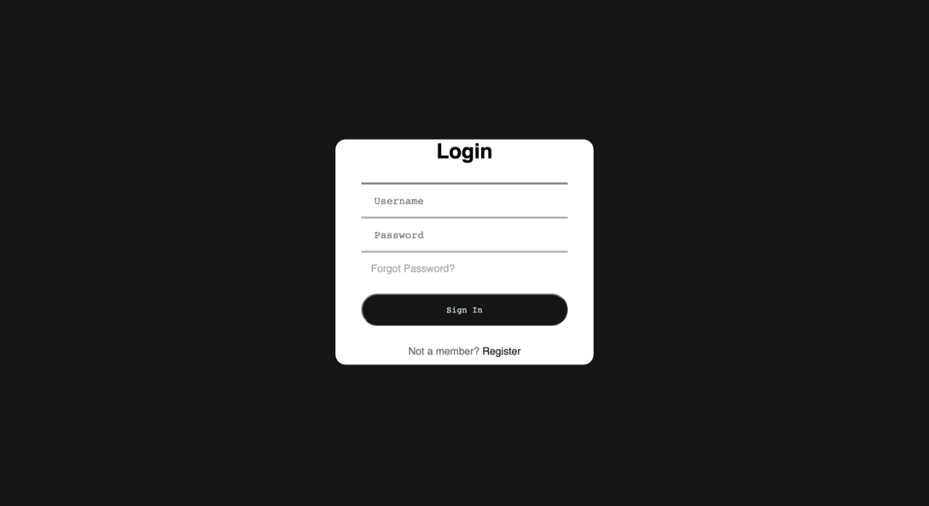
Front End Web Pages:

Slide 22
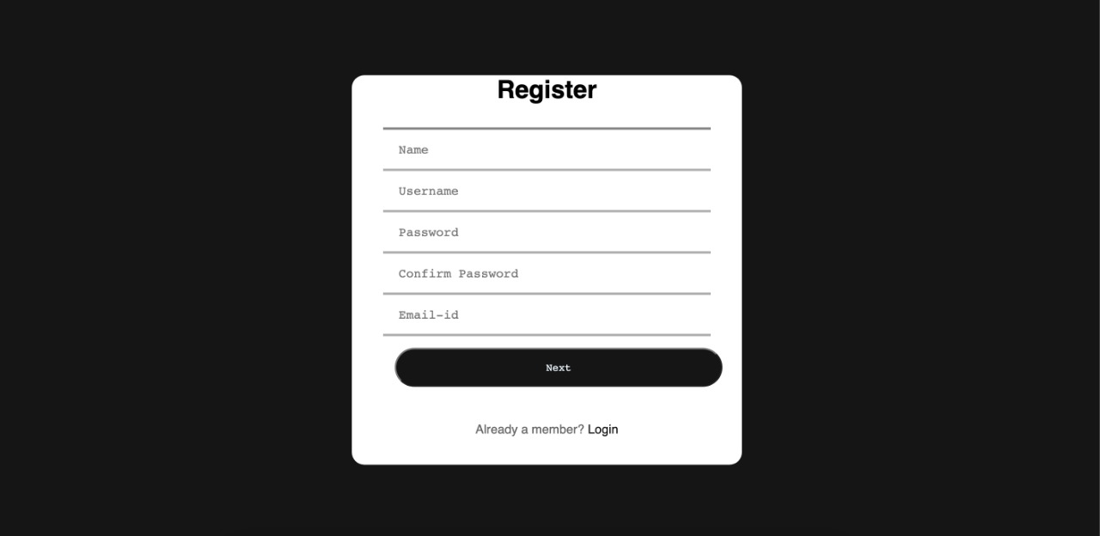
Front End Web Pages:

Slide 23
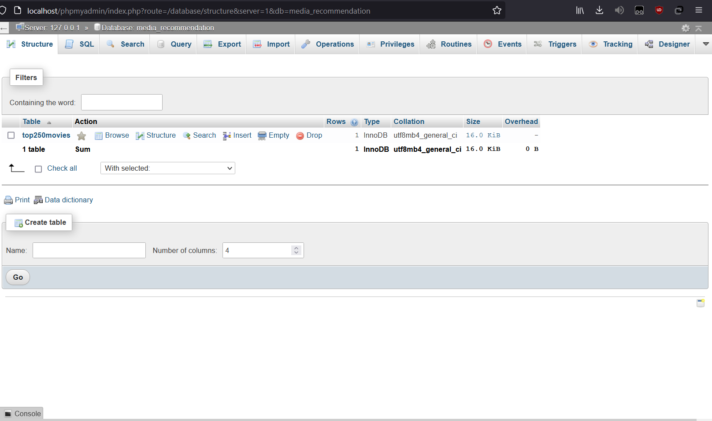
SQL DB

Slide 24
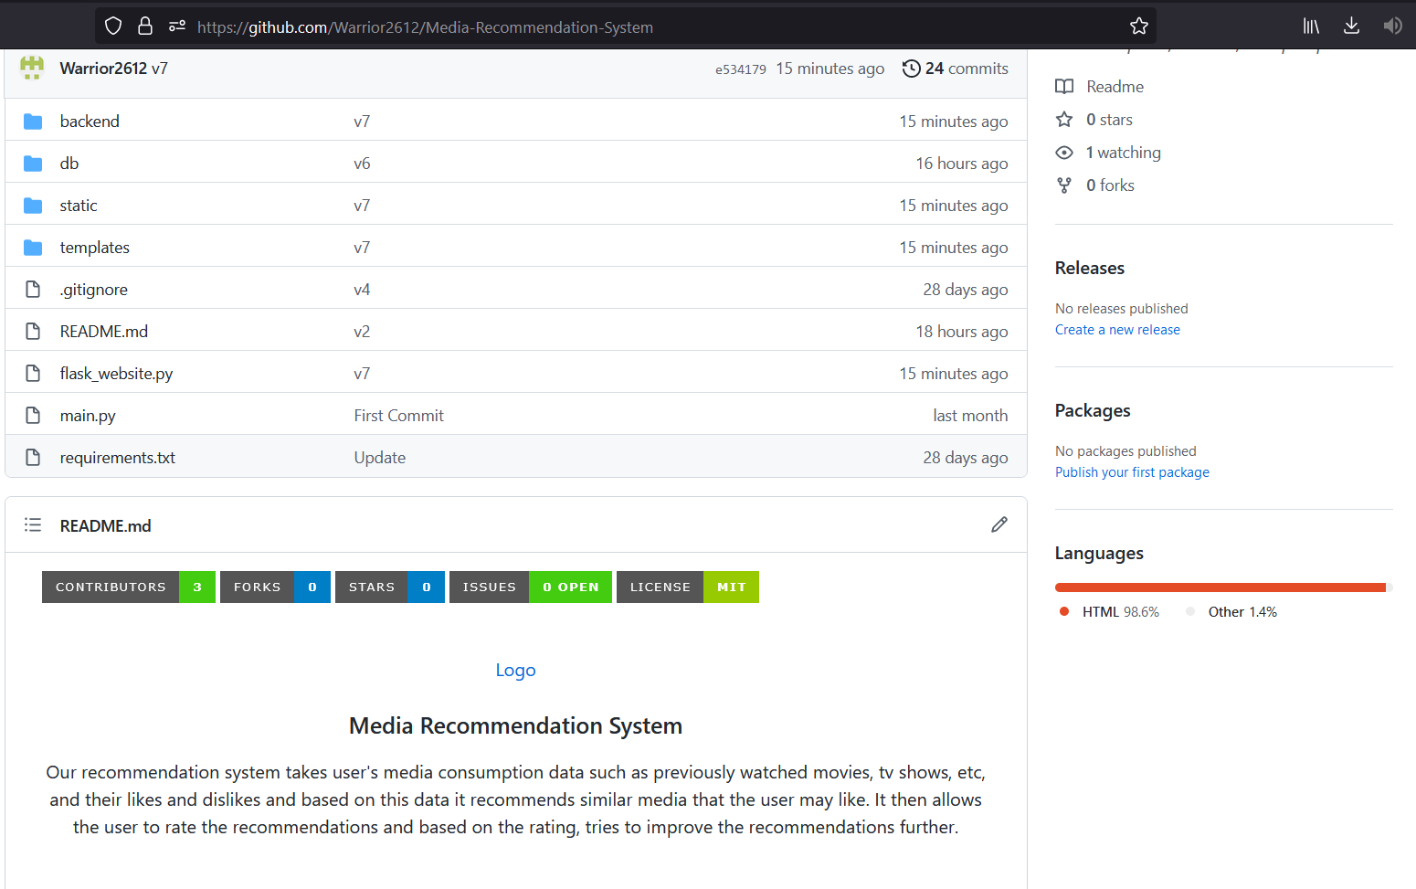
GitHub:
https://github.com/Warrior2612/Media-Recommendation-System

